Slide 1
What is a grant? Understanding the alphabet soup from funding agencies
Research Infrastructure talks
08/12/20

Slide 2
What is a grant?
A financial / legal contract between an institution (UF) and a granting agency for a faculty (principal investigator, PI) to perform a task (research)
All grants have to be submitted through the Division of Sponsored Research (DSP) that guarantees oversight to the granting agency.

Slide 3
What is a grant?
The total grant is the sum of
direct costs: go directly to the PI to support salaries and supplies necessary to perform the project
Indirect costs (IDCs, F&A or overheads): go to the institution as cost of doing research

Slide 4
Facilities & Administrative (F&A) or Indirect Costs (IDC) at UF
Negotiated IDC Rates:
In order to use a different IDC rate the sponsor must have a posted policy of what rate to use (for example, JDRF uses 10% rate)
NIH Ks and T32s are NIH, but only allow for 8%
Type of Activity | On-Campus | Off-Campus*
Research | 52.5% (negotiated NIH) | 26%
Other Sponsored Activity | 32.6% | 26%
* In order to use Off-Campus rate you will need to budget for some type of rent expense as part of your direct costs (for example, a lab at Rocky Point

Slide 5
How are IDCs used?
Departments and Centers / Institutes need your IDCs to support your research (more later)

Slide 6
Not all grants are created equal
Any grant is better than no grant
But
Extramural
Federal (NIH, DOD)
State
Industry
Foundations
Institutional (UF) (no IDCs)
best

Slide 7
Why?
Indirect costs (IDCs)
Ranking
The Blue Ridge Institute for Medical Research ranks U.S. Medical Schools by analyzing the National Institutes of Health (NIH) grant awards each year

Slide 8
Strategy
It is critical to understand what funding program is the best for your research project
First step is to know the different types of grants that you can apply for

Slide 9
Glossary
Request For Applications (RFA)
Funding Opportunity Announcement (FOA)
NIH:
Program Officer: in charge of a portfolio of grant applications and funded grants. Your liaison with NIH.
Scientific Review Officer: Organizes grant reviews in either a standing study or a SEP (special emphasis panel)

Slide 10
Glossary
Principal Investigator,
Multiple PI,
A Co-Investigator is an individual recognized by the Institute and the Principal Investigator as someone making a significant contribution to a project. The Co-Investigator is an individual that the PI relies on to assume responsibilities above those of other personnel.
Senior/key personnel are defined as individuals who contribute to the scientific development or execution of a project in a substantive measurable way (all faculty paid on the grant)

Slide 11
NIH is trying to help first awards with increased funding rates to:
An Early-Stage Investigator (ESI) is a New Investigator who has completed his/her terminal research degree or medical residency (or the equivalent and whichever date is later) within the past 10 years and has not yet been awarded a substantial, competing NIH research grant.
A new investigator (NI) has not yet been awarded a substantial, competing NIH research grant.

Slide 12
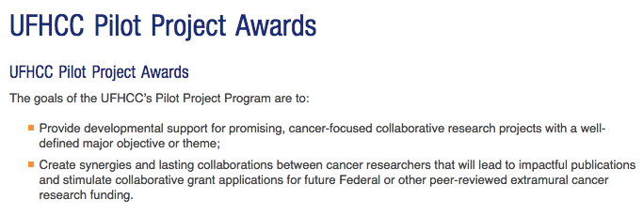
UF grants
VP for Research
Opportunity Funds: 2-year ~ $50K, requires collaboration between 2 (or more) investigators with different expertise, ideally from different colleges, or at least departments
Specific announcements

Slide 13
UF grants

Slide 14
State of Florida funding opportunities
FY 2018-2019 FOA: all cancer related
http://www.floridahealth.gov/provider-and-partner-resources/research/funding-opportunity-announcements/BC.JEK.LLBFrequentlyAskedQuestions2018-2019.pdf
James and Esther King Biomedical Research Program (King)
Bankhead-Coley Cancer Research Program (Bankhead-Coley)
Live Like Bella Pediatric Cancer Research Initiative (Bella)

Slide 15
Foundations
You are the expert in finding the right foundation for your research
Variable format, requirements, deadlines, etc

Slide 16
Industry
Contract between you and the company
IDCs: lower than NIH but fixed
Involves IP, consult with UF Tech transfer

Slide 17
DOD

Slide 18
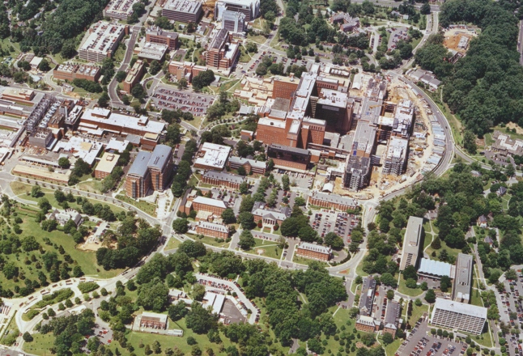
NIH
Intramural research and clinical center
Bethesda, MD

Slide 19
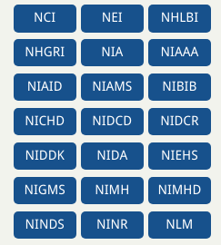
National Institutes of Health
21 institutes
Each grant proposal is assigned to an institute
PI may suggest an institute, but NIH makes the ultimate choice

Slide 20
Two types of submissions
Regular submission cycle,
3x/year, R, K, F awards
1x/year T, S10
Specific RFAs or FOAs
All limited to US citizens / permanent residents
Continuous submission for study section members is ending
new | Feb 5 | June 5 | Oct 5
Renewal, Resub | March 5 | July 5 | Nov 5

Slide 21
Types of awards
Investigator initiated individual R01
5 years $250-500 K/ year
Requires significant amount of supporting results (published and unpublished)
Can be renewed (competitive renewal)
R21: Exploratory/Developmental Grants
2 years, $275 K total, non-renewable
No preliminary data required (in theory)
Not accepted by all institutes
Does not recognized new investigators
R43/R44 Small Business Innovative Research (SBIR)

Slide 22
F (fellowship) awards T32: training grant (for a program)
F30: MD/PhD
F31: PhD
F32: postdoc
Under-represented minorities / disability are reviewed separately
T32: training grad students, postdocs, fellows

Slide 23
U-types of Research Project Cooperative Agreement
Supports discrete, specified, circumscribed projects to be performed by investigator(s) in an area representing their specific interests and competencies
Used when substantial programmatic involvement is anticipated between the awarding Institute and Center
One of many types of cooperative agreements
No specific dollar limit unless specified in FOA

Slide 24
NIH Career Developmental Awards

Slide 25
Program grants
PO1: at least 2 projects and two cores. Pre-proposal needs to be approved before submission
P30 Centers Program—Research Core Grants
P50 Centers Program—Full-Scale Specialized Center Grants

Slide 26
